Slide 1

BIOFIN
The Biodiversity Finance Initiative
Power generation in Sri Lanka:
Compromising biodiversity due to market failures
  Mobilising Resources for Biodiversity and Sustainable Development

Slide 2
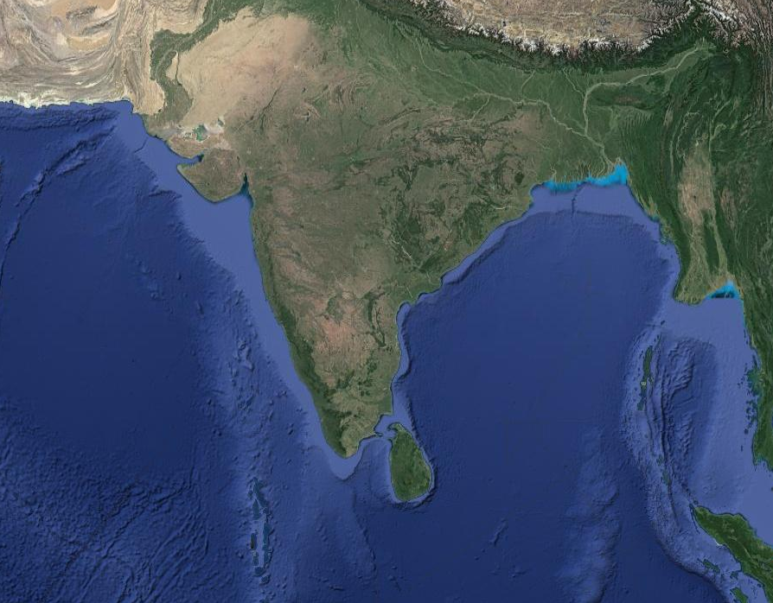
Sri Lanka- Pearl of Indian Ocean
Sri Lanka
Notes:
Sri Lanka is an island in the Indian Ocean. Under normal circumstances it receives rain throughout the year. With the 103 rivers flowing from the hilly areas located in the middle part of the country, it has a great potential to generate hydro electricity. In fact hydro electricity was the main source of power supply till early 1990’s.

Slide 3
Country at a glance
Population 21 million
Land area 65,610 km²
GDP Per capita 3,835 USD (2016)
GDP Per capita (PPP) 12,811 USD (2017)
Livelihoods
      Agriculture 26.1%
      Industries 28.4%
      Services 45.5%
Electrification level 99.3%
Per capita electricity consumption 626.3 kWh
Notes:
With the increasing demands for household as well as industrial usage, per capita electricity requirement has gone up considerably during last twenty years. Ensuring national grid connectivity as well as 24/7 uninterrupted power supply are being considered as key responsibilities of the government.

Slide 4
Notes:
With the increasing pressure to produce more electricity, the government has opted for coal and fossil fuel based energy production in the late 90’s and first decade of 2000. Drive for renewable options such as solar power and wind was either absent or limited to areas where national grid connectivity was not available. With the prolonged drought periods the country experienced, the coal and thermal generators were asked to contribute more as actual hydro power generation came down.

Slide 5
Generation Vs Capacity
Notes:
Compared to the percentage of installed capacity, percentage of actual generation provides a view on the utilization ratio. In Sri Lanka it was highest for coal and followed by fossil fuel. Both needs to be imported 100% so creating a heavy burden on the national budget.

Slide 6
Cost of production
Notes:
Policy makers identified coal as the second cheapest option to generate power- second only to hydro power. Future Generation Plan of the Ceylon Electricity Board which is the government owned national grid operator and main lobby group on the electricity generation is heavily dependent on the coal options. They have underestimated the costs related to environment pollution, social costs of environment pollution etc.

Slide 7
Main issues
Assuming coal as the best way forward as externalities are not being considered
Exhausted hydro power generation capacity
Low efficiency of existing hydro power generators
  Government owned
  Private owned

Slide 8
Hydro power issues
Plant factor =
Actual energy production during a given period
Potential energy production during that period
All major power plants operated below 50% plant factor
Only 5 plants out of 17 operated with more than 40% plant factor
5 plants operated with less than 20% plant factor

Slide 9
Plant factor of major hydro stations-2016

Slide 10
Many mini hydro plants operate at sub optimal levels

Slide 11
Main reasons – major hydro power plants
Erratic rainfall (Climate Change impacts)
Reducing water holding capacity of reservoirs due to siltation
Prioritization of irrigation requirements (to irrigate large areas water is being diverted before generating electricity)

Slide 12
Main reasons – mini hydro power plants
Inadequate water flow during the dry season
  Poor land use management in the catchment
Vandalism
  People living in surrounding areas see mini hydro operators as aliens who have come to the area only to make profits

Slide 13
Solutions
Both major and mini hydro operators want to see a catchment of better health condition
Need to invest on soil conservation and promote improved land use practices
Need to understand the causal effect relationship between mismanagement of catchment and the poor water flow
Create interdependent symbiotic relationship between the plant operators and the land holders in the catchment

Slide 14
Sensitizing power generation in Sri Lanka to environment realities
Payment for Eco system Services
Understanding the externalities of coal and fossil fuel based power generation
Setting up a mechanism for major hydro power plants where..,
Buyer = electricity consumers
Seller= Land owners of upper catchment
Setting up a mechanism for mini hydro power plants where..,
Buyer = private plant operators
Seller= Land owners of upper catchment

Slide 15
BIOFIN support to the government
Work with Public Utilities Commission of Sri Lanka (PUCSL) to study the externalities of coal power generation
Work with Ministry of Mahaweli Development and Environment and PUCSL to initiate a PES scheme in Moragahakanda reservoir
Work with IUCN to initiate a PES with a mini hydro operator

Slide 16
Investing in biodiversity for a prosperous future

